Slide 1
Quadruped Robot for Agricultural Research
Team: Austin Neff, Kevin Nelson, Jordan Raver, Ben Seisser, Sam Spencer, Yang Yang
Team Advisors: Shad Roundy, Kam Leang

Slide 2
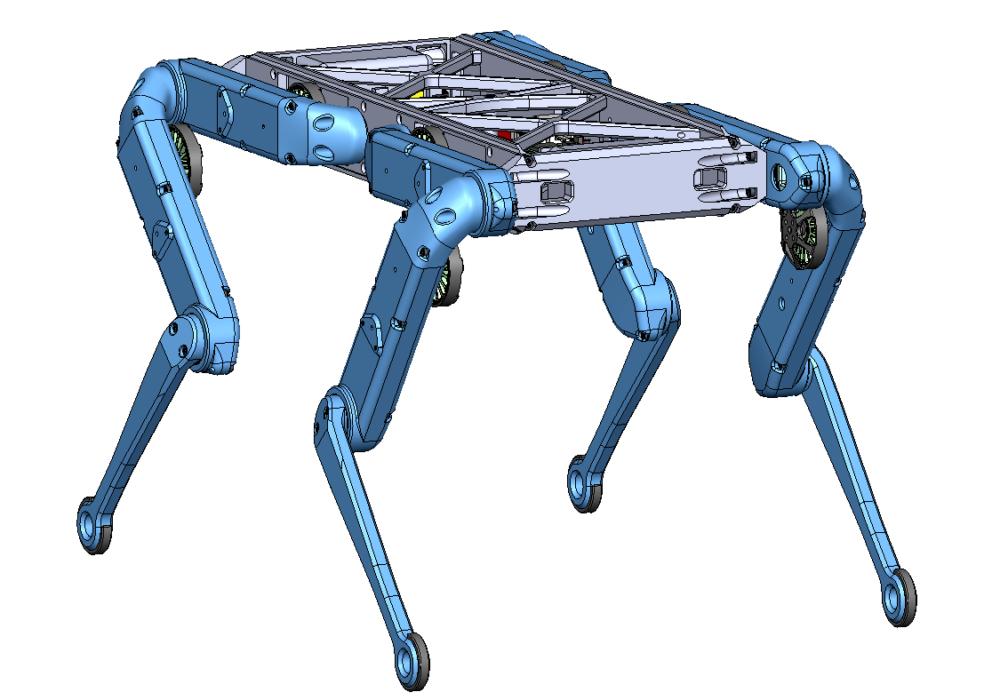
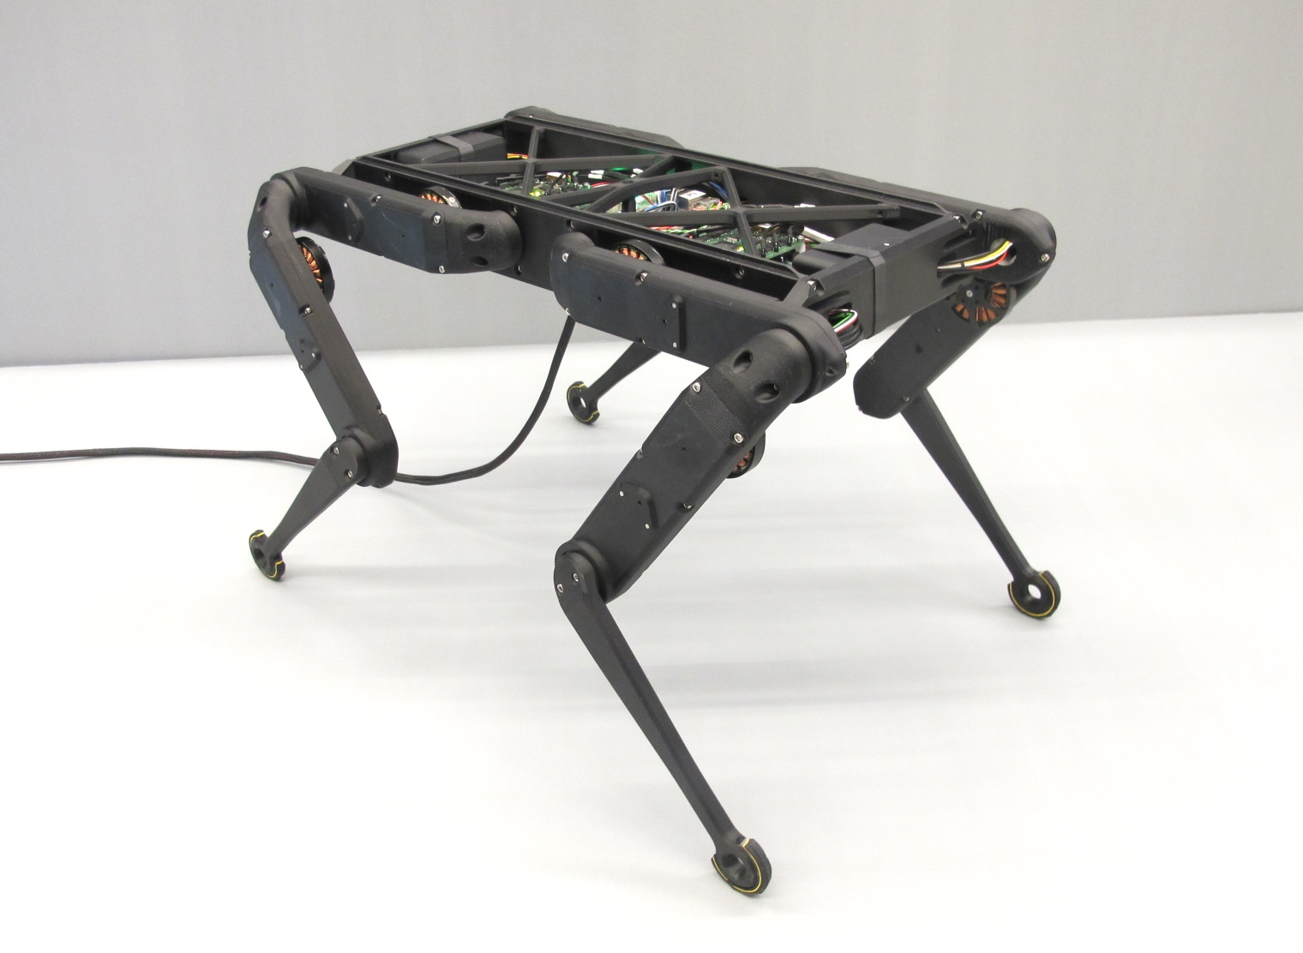
Project Objective
The objective of the project is to construct a quadruped robot. The Open Dynamic Robot Initiative will be followed closely. The robot is intended as a cheaper alternative for robot smart agriculture than what is currently available in professors Roundy and Leang’s laboratories.

Slide 3
Project Objective - Scope Recap
Problem: Advisors requires a quadruped design that can perform tasks on a field
Objectives: Create a quadruped robot
ROS2 Humble Compatible
Autonomous
1-2 Hour battery life
Able to navigate to four points in a field
Enclosed, easily storable design
Red for school spirit (Go Utes!)
Final design will be able to achieve all objectives at a reasonable price and can be expanded on in the future to provide more advanced functions

Slide 4
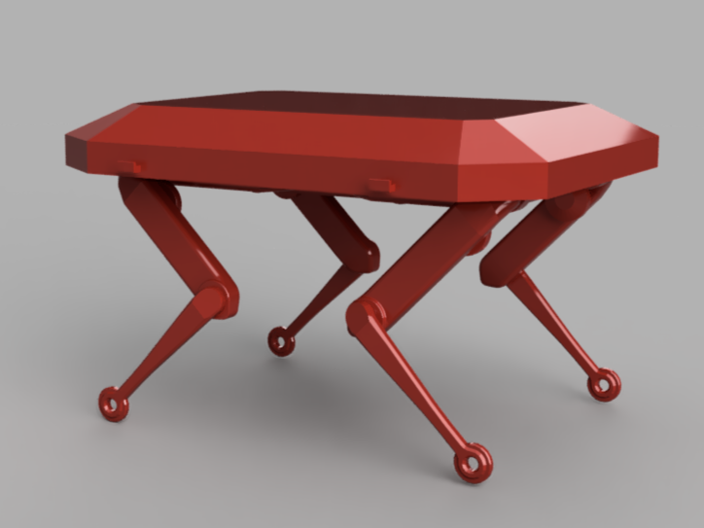
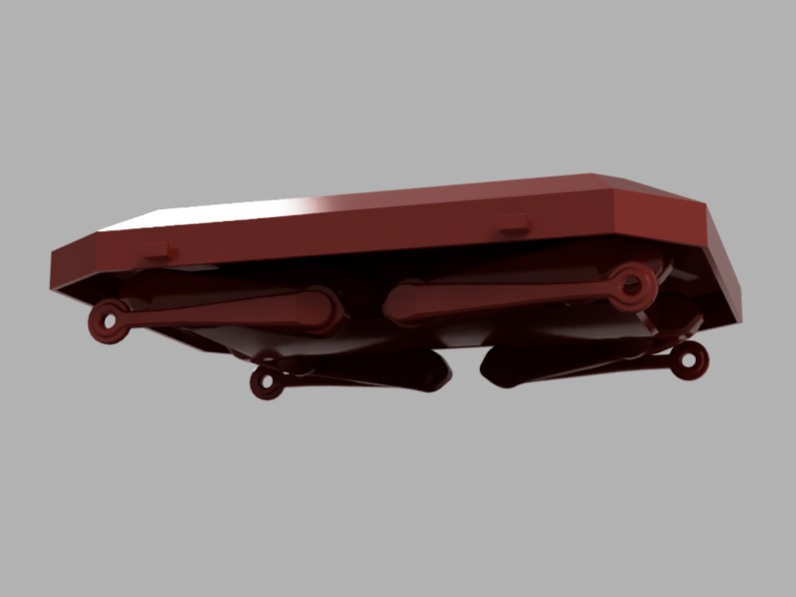
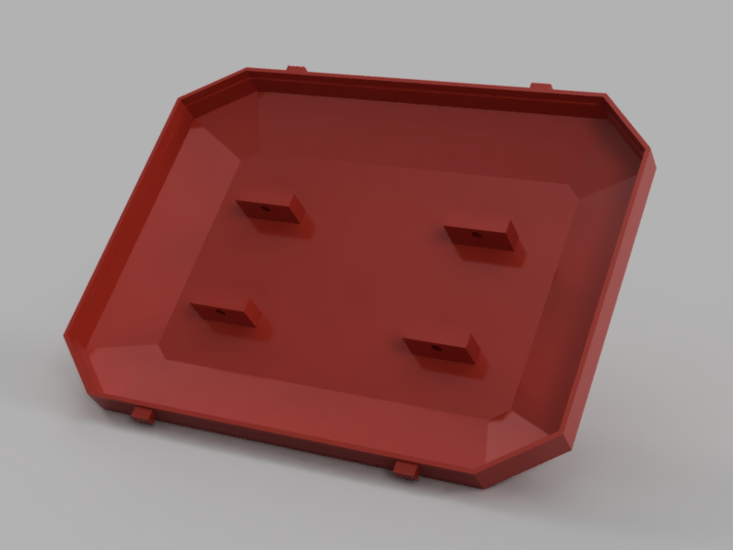
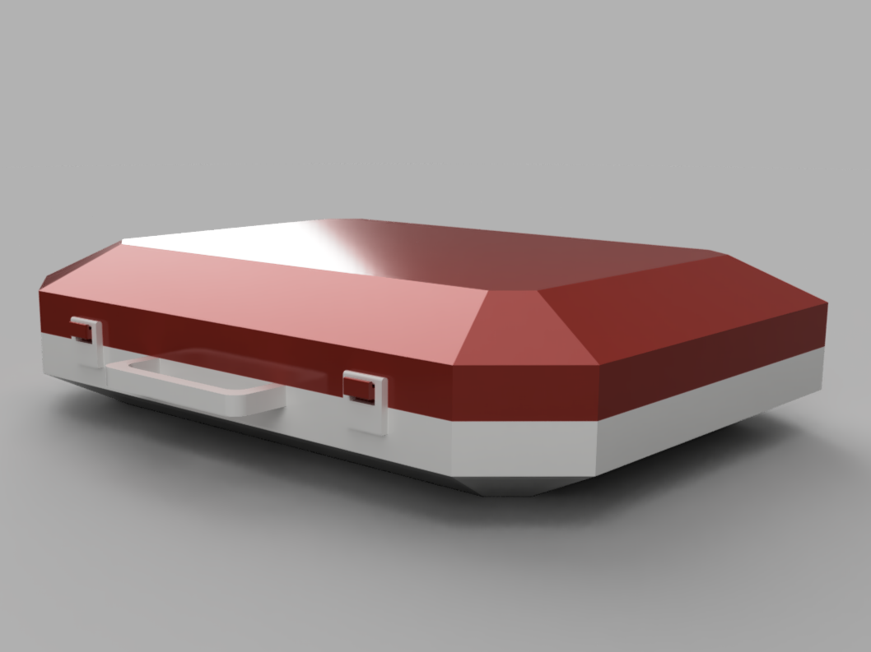
Design Concepts - Dual Purpose Lid with Case
Protects electronics and motors
Reduces components require for carrying case
Pros: weather cover, easy storage
Cons: not easily removable

Slide 5
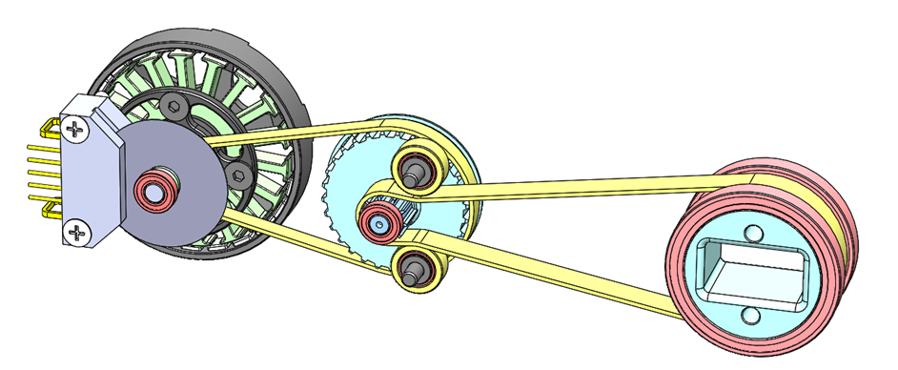
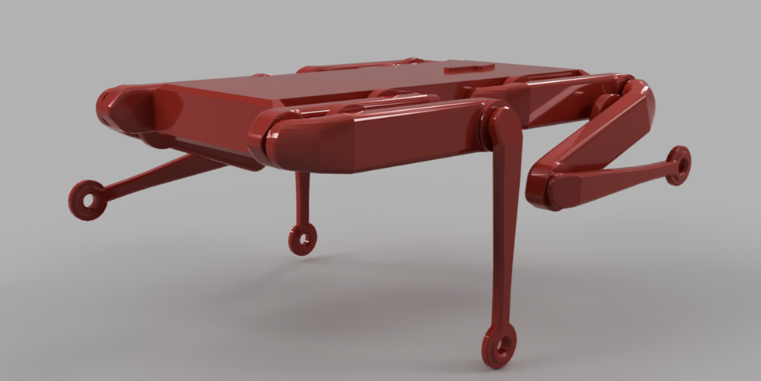
Design Concept Analysis - Actuator Torque
Analysis done in “worst case scenario”
Calculate Gear Ratio
Calculate peak torque of brushless motor
Calculate possible acceleration

Slide 6
Design Concept Analysis - Actuator Torque
Torque = Kt*Current*Gear Ratio
Gear Ratio = R3/R1 * R4/R2
Force = m*g
Resistance Torque = 0.5*Force*L
Net Force = Force at Actuator - Force of Gravity
Results
Gear Ratio = 9.52
Torque Output = 3.57 Nm
Vertical Acceleration = 28.38 m/s²

Slide 7
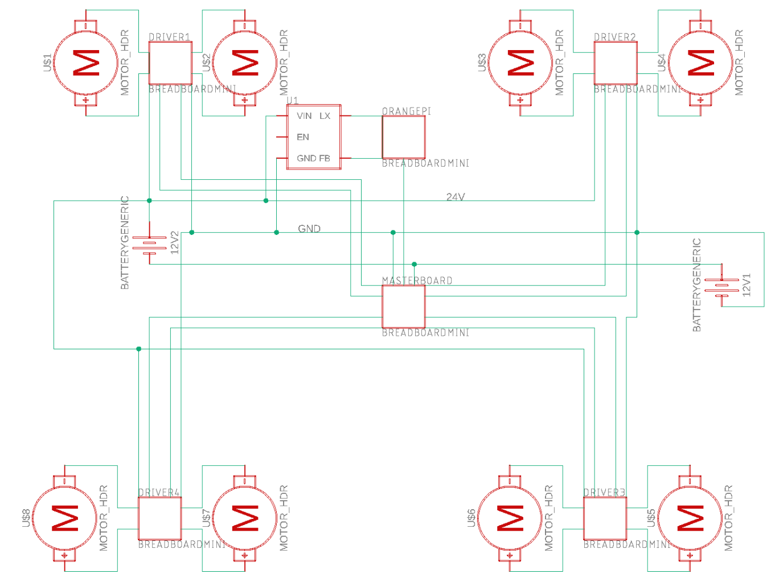
Design Concepts - Untethered Power System
This concept is based off of the “untethered” constraint of our robot. This semester’s scope is limited to making the robot move but we’re likely to pursue this design next semester.

Slide 8
Design Concept Analysis -
System Cooling Requirements
Most chips in system have a 150C limit
At team estimates, forced cooling/fans may be considered
Temperatures will be monitored for final conclusion
Property | k_{air} [W/mK] | A_{board} [m] | Pr_{air} | kSi [W/mK] | t_{board} [mm] | v [m2/s] | L_{c} [m] | T_{max} [K]
Value | 0.02551 | 0.025 | 0.7296 | 93.679 | 1 | 1.562 E-05 | 0.00175 | 423
Source | Power [W] | Velocity [m/s]
ODRI Limit | 288 | 1.56391
Team Estimated Average | 180 | 0.61034
ODRI Average | 10 | 0.067746

Slide 9
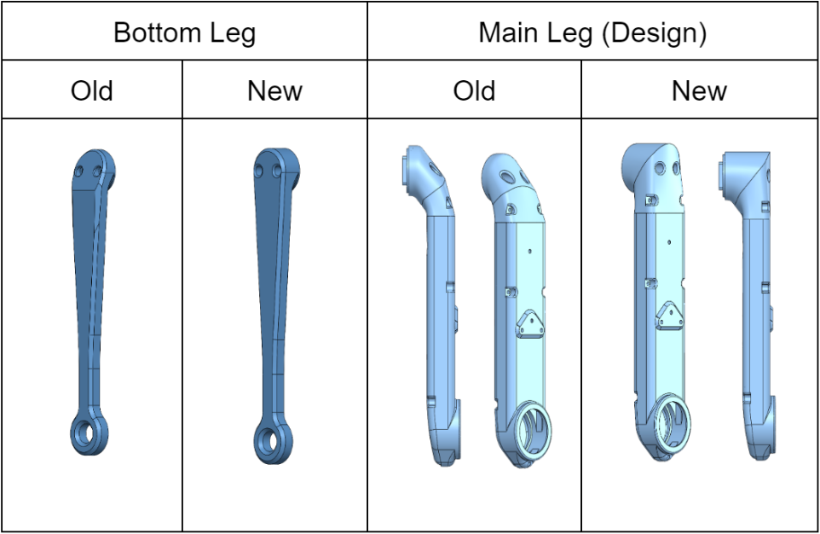
Design Concepts - Redesigned Legs for 3D Printing

Slide 10
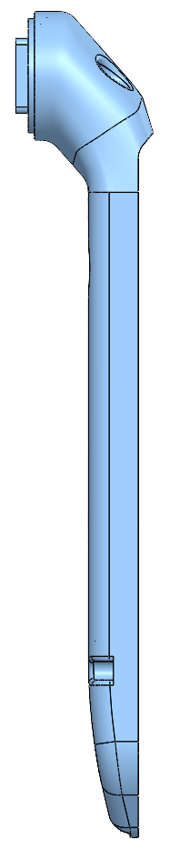
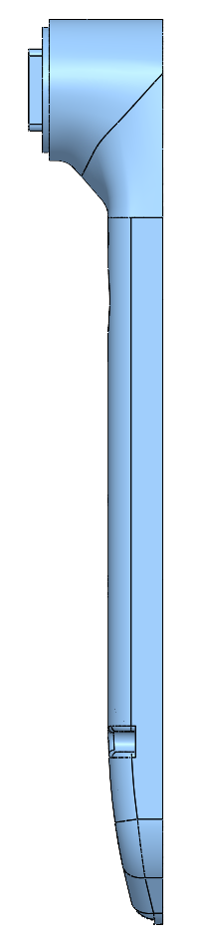
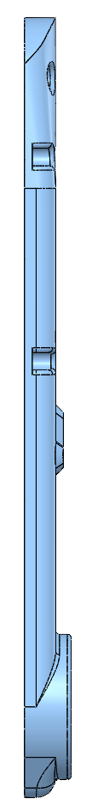
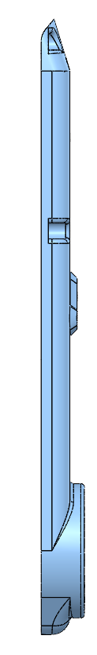
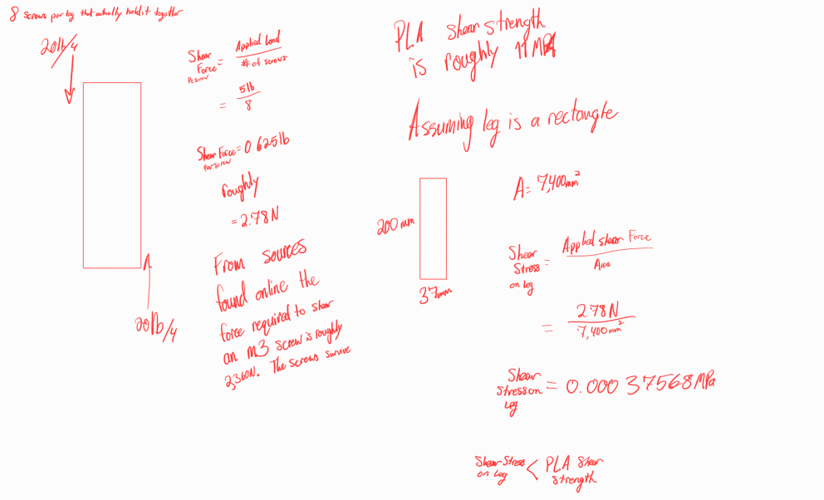
Progress: Main Leg Simplicity Redesign
Original Left
Modified Right
Notes:
The new and currently used method of printing has led to the outside looking smoother and neater. The area between the cover and the shell has also became smoother as a result because the parts are printed on a flat surface.
(Info From Assignment 4) A main concern was whether or not the small notch in the original leg was needed. Through various calculations I found that a leg can fully withstand the total weight of the robot.

Slide 11
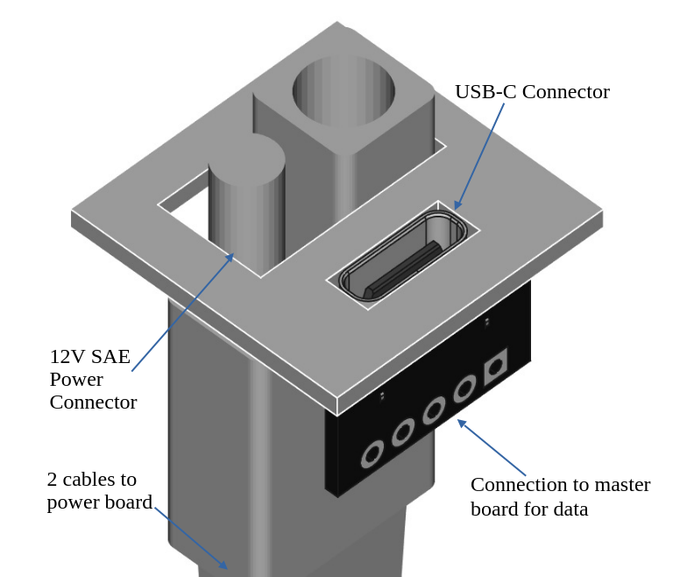
Design Concepts - Data and Power Connection
A theoretical data and power connection for robot modules or tether. The panel containing the ports would be integrated into the robot’s back panel.

Slide 12
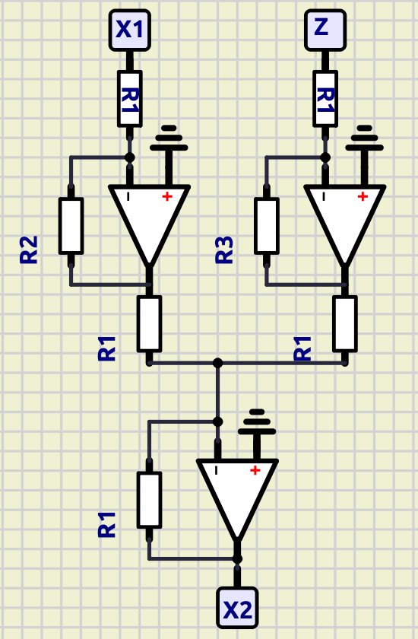
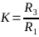
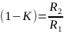
Design Concept Analysis - IMU Filtering
This design concept was on a filter for our IMU, as our choice of IMU has no built in filtering as recommended by the Open Dynamic Robot Initiative. Without the filtering our IMU is not accurate down to the 0.1 mg range we require in our design metrics.
is the governing equation for the filter, where K is the weight of measurement while X are the predicted measurements and Z is the actual measurement.
A series of op amps can be used to run the filter, without any computational load on the Orange Pi, by choosing R₂ and R₃ for a given K.
Specifically, and
A python script has been prepared to test different K values digitally before a physical circuit is constructed.

Slide 13
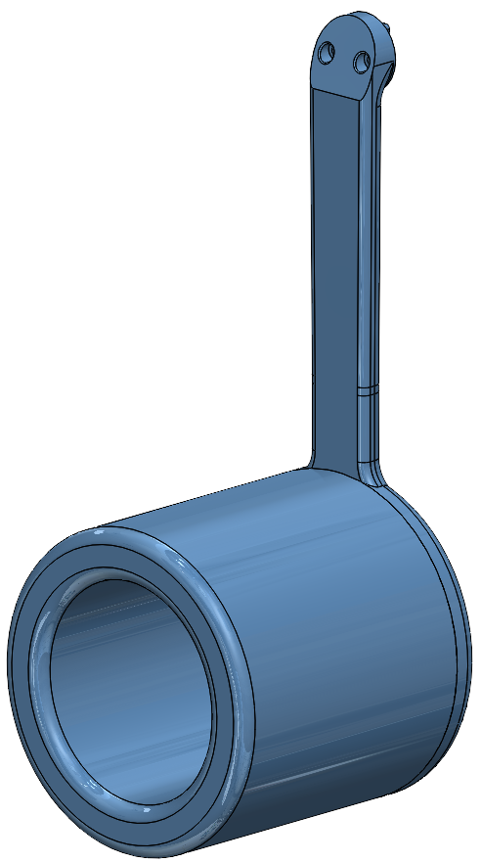
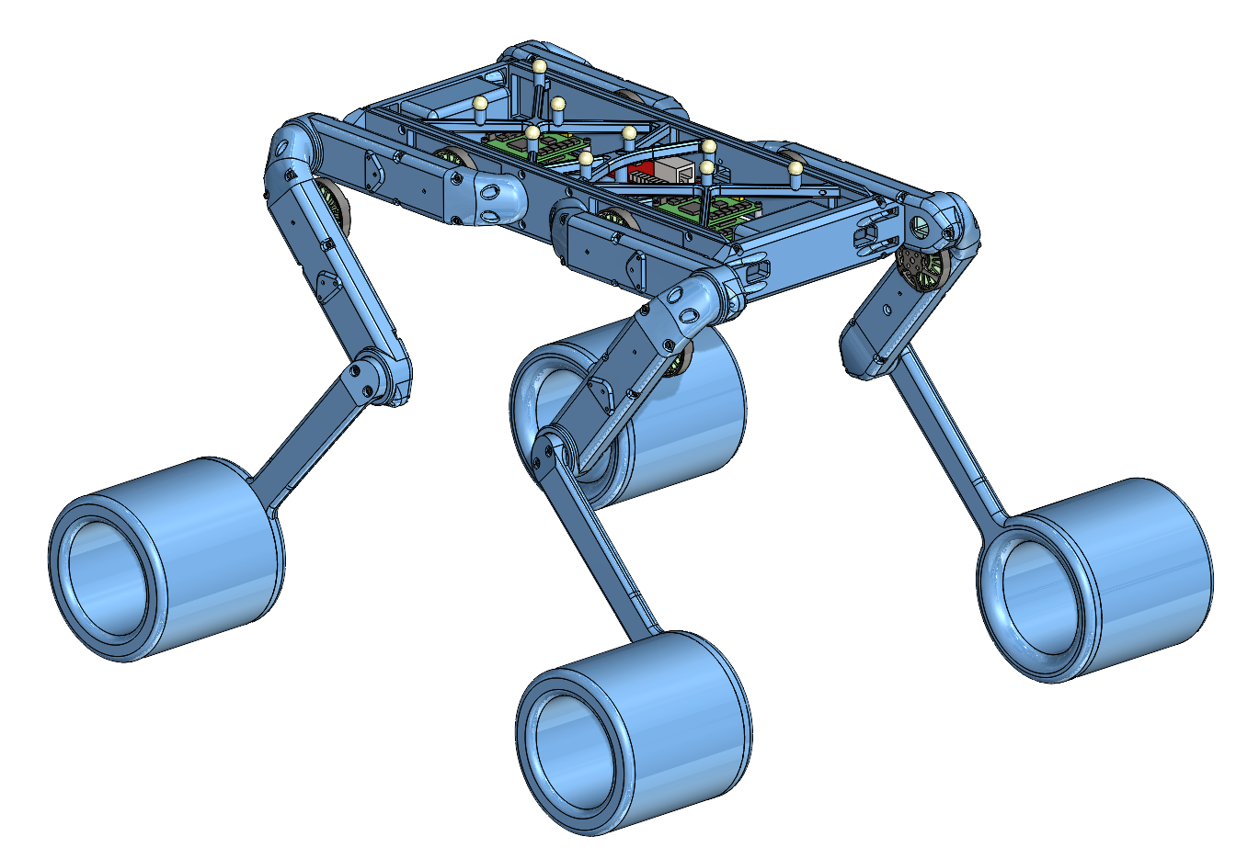
Design Concepts - Large Feet for Muddy Conditions
One major problem that it might face is muddy conditions. This foot design concept is much larger than the previous version to increase its surface area, almost like a snowshoe.

Slide 14
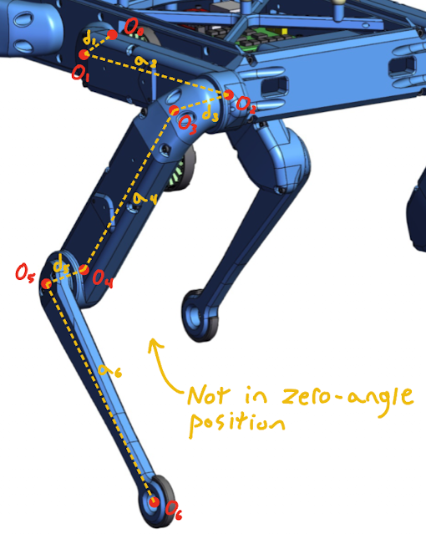
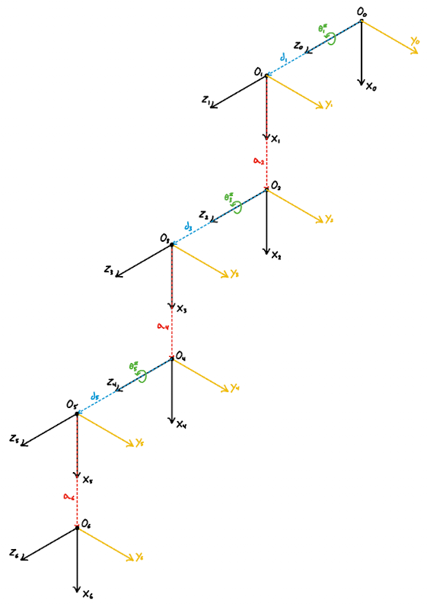
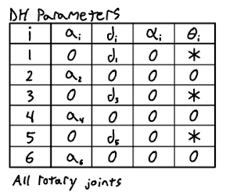
Design Concepts Analysis - Leg Endpoint Equations
Diagram of a leg in zero-angle position. This helps us better visualize each link and their corresponding origins. We are able to use the DH parameters to find the endpoint equations.

Slide 15
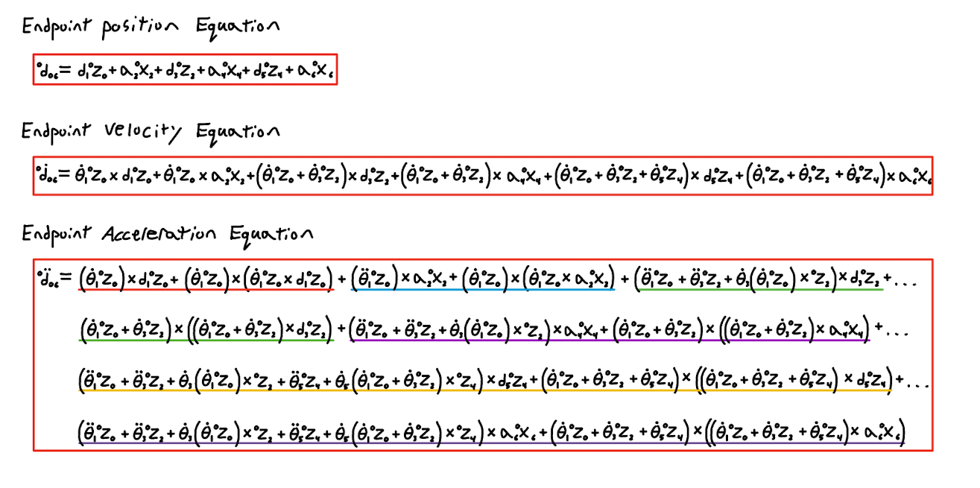
Design Concepts Analysis - Leg Endpoint Equations
One of the most important things when working with robots is knowing where the endpoint is and where it needs to be. In this case, the endpoint is the foot of the leg. These endpoint equations to the right (position, velocity, and acceleration) allow us to know what it’s doing based on what each motor is doing.
We can further use these equations with inverse kinematics. We can give the robot a specific endpoint position, velocity, and/or acceleration parameter, and through inverse kinematics, we can solve for those parameters for each individual motor.

Slide 16
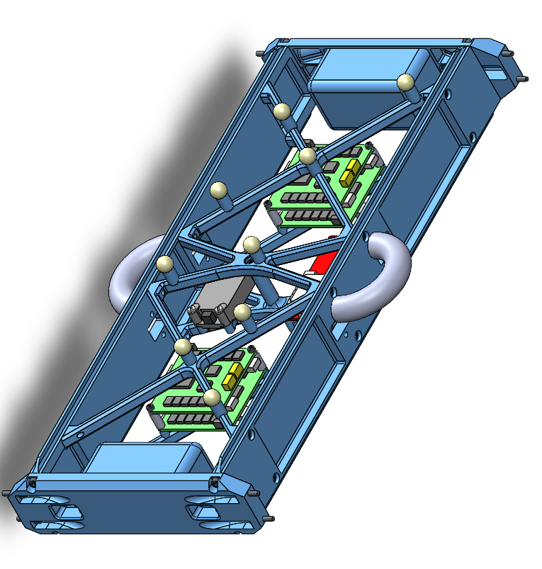
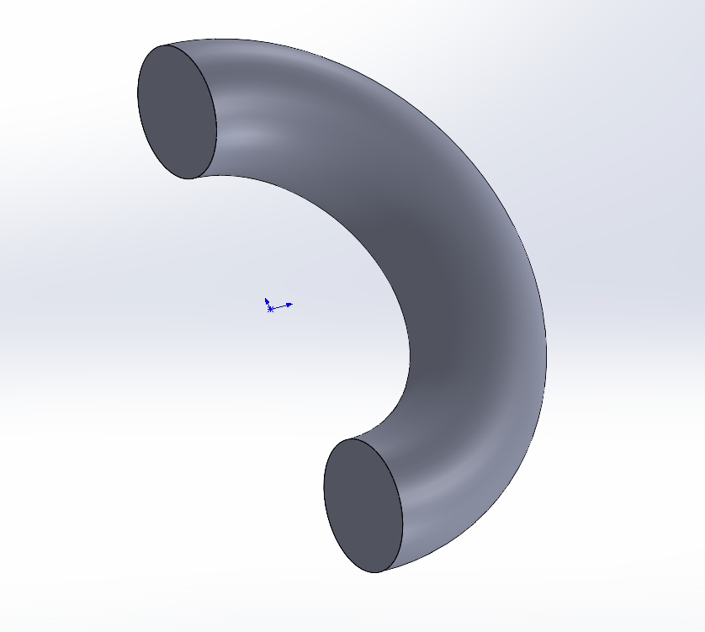
Design Concepts - Two Handles for Easy Carrying
Large enough to hold
Ergonomic
Absorb fall impact

Slide 17
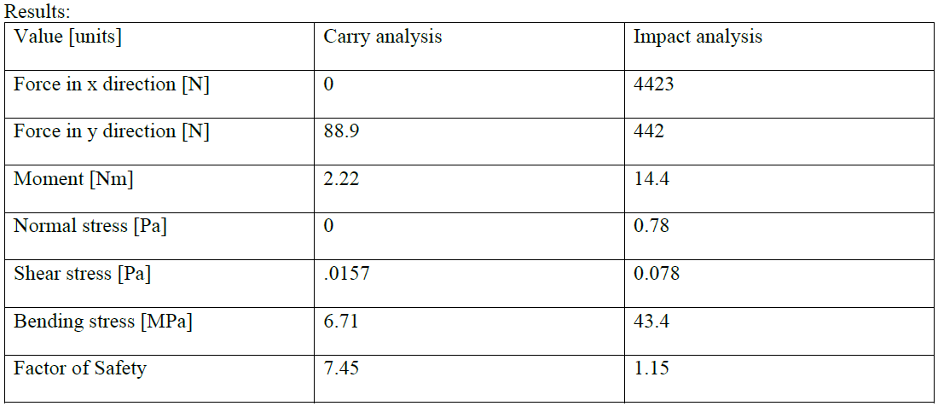
Design Concept Analysis - Handle Durability
15mm thickness
25mm radius of curvature
Bending stress is most harmful
May make larger to be more ergonomic
Carry and Impact analysis
May make larger to be more ergonomic
Carry and Impact analysis
MATLAB code ready for other dimensional analysis

Slide 18

Proof-of-Concept Test Plan
Our overall goal is to have a full PLA prototype using the Orange Pi 5 and servo control motor drivers by the end of the semester
Our testing will be on basic robot motion
For the current expected arrival date of the motor encoders, we do not expect to have enough time to develop full walking software by the end of the semester
A basic jump motion
A crouching motion
Individual leg lifts

Slide 19
Proof-of-Concept Test Plan
Our overall goal is to have a full PLA prototype using the Orange Pi 5 and servo control motor drivers by the end of the semester
Our testing will be on basic robot motion – some measurements we will use to determine success include:
Encoder read/write rate (greater than 40 kHz)
Smallest increment of motor motion (maximum of 0.1 degrees)
IMU update speed (greater than 1 kHz)
IMU noise level (less than 0.1 mg)
Robot response time matches IMU (less than 1 ms)
Some other data we will collect during testing for future design work include:
Peak current draw
Average power usage
Operating temperature
Motor response to applied impulses

Slide 20
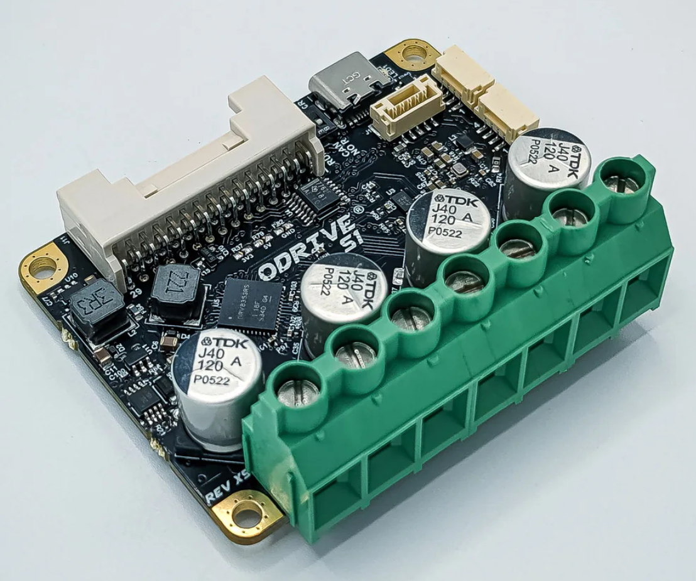
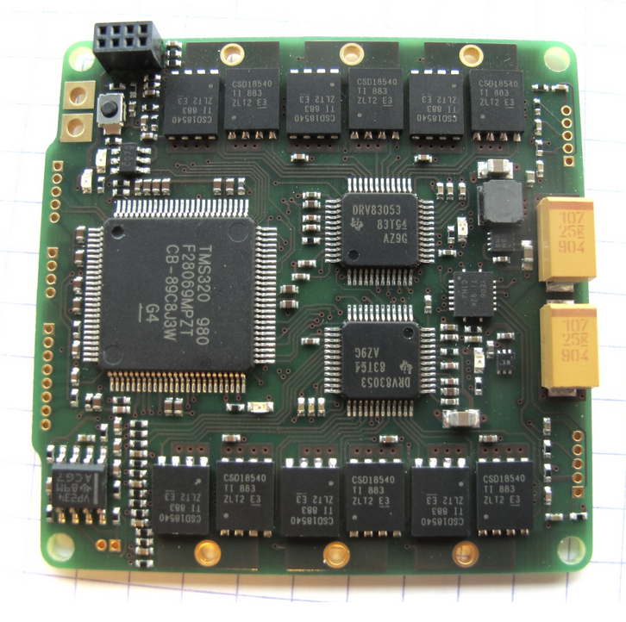
Technical Issues - Drivers and Master Board
Too expensive; $3000 for custom ODRI boards
Unusual and deprecated software architecture
Solution: Off the shelf components and custom software
Potential brushless motor position control boards ordered for testing, decision should be made by the end of next week
Master board will be replaced completely by onboard Orange Pi
Total cost estimates depending on the driver become $400-$1300
Vastly improved lead times also allow for additional development time on our end

Slide 21
Current Budget
Total Available: $6000
Total Spent: $2740.67
Estimated Total for this semester:
$3569.25 if we use the ODrive controllers
$2764.18 if the ODrive imitators have enough capacity and support
Tentative estimate for power system cost next semester: $400

Slide 22
Plans
Week of 10/21/24
Finish fleshing out testing plan
Finish robot block diagram
Week of 10/28/24
Test motor control board libraries on motors with temporary encoder
Develop full set of endpoint equations to describe full motion of the robot
Design inverse kinematic system to control the robot
Week of 11/4/24
Order the rest of the boards after making decision
Augment chassis to fit motor controller boards and Orange Pi
Week of 11/11/24
Begin work on ROS2 implementation and robot prototype assembly

Slide 23
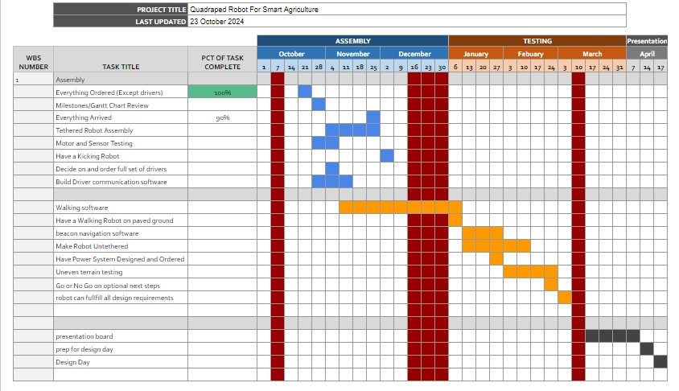
Gantt Chart

